Slide 1


BOOK INVENTOR SYSTEM
Professional Practice in SE

Slide 2





ABU HURAIRA
BSE-21S-007
GROPU
MEMBERS
SHAHROON KHAN
BSE-21S-075
ZARNOSH KHAN
GET TO KNOW US
BSE-21S-092
OWAIS ASAD
BSE-21S-062

Slide 3

INTRODUCTION
OVERVIEW
TECH STACK
PRESENTATION OUTLINE
MERN SATCK OVERVIEW
INTEGRATIONS
AUTHENTICATION
PROJECT ARCHITECTURE
FEATURES

Slide 4

BRIED OVERVIEW
it is a library management system is an application organizing library resources, and managing books for efficient operation
It allows to add, delete, and edit books

Slide 5

OBJECTIVES
Efficiency
User Accessibility
Data Accuracy
Security
Organization
User Management

Slide 6

3. TECH STACK

Slide 7
What is it?
A Tech stack is a set of technologies and tools used to build and deploy this application

Slide 8
MERN STACK
FULL-STACK JAVASCRIPT DEVELOPMENT

Slide 9



TECH STACK
FRONTEND FRAMEWORK
REACT.JS
BACKEND FRAMEWORK
NODE.JS
EXPRESS.JS
DATABASE
MONGO.DB

Slide 10




TECH STACK
AUTHENTICATION
FIREBASE AUTHPROVIDER
VERSION CONTROL
GIT
PACKAGE MANAGER
NODE PACKAGE MANAGER(NPM)
STYLING
MATERIAL UI
AND
FLOWBITE REACT

Slide 11

KEY FEATURES

Slide 12
APP FEATURES
UPLOAD BOOK
UPDATE BOOKS
admin can upload a new book
admin can update a book
DELETE BOOKS
PURCHASE BOOKS
admin can delete existing book
user can purchase a book

Slide 13

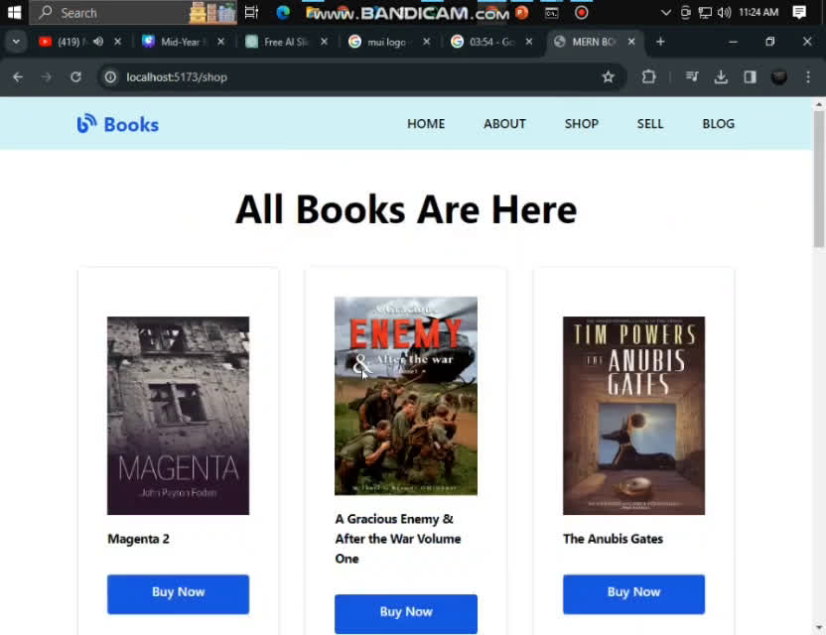
PROJECT DEMONSTRATION

Slide 14

THANKS TO LISTEN TO US
ANY QUESTION?

